Slide 1
Writing high performance C#
Suggestions & best practices

Slide 2
Agenda

Slide 3
Agenda
Writing high performance code in C#
by Bart de Smet @Techorama conference
by Marc Cortada
We have some good practices and suggestions
Most of them with small demos
Tools for performance
Miscellaneous
Some safe and secure coding notes
by Barry Dorrans @Techorama conference

Slide 4
Who is Bart de Smet?
Bart De Smet is a Principal Software Development Engineer working on large scale stream processing systems in the Applications and Services Division at Microsoft Corporation, a course and book author, and a popular speaker on various international conferences.

Slide 5
Who is Marc Cortada?
Marc Cortada is a Software Engineer working at ING Belgium. He has more than 10 years of experience related with software development and has collaborated in the development of real time applications, high concurrency environments, and managed big volumes of data and transactions. Also, he has taken part in tasks of administration of databases and architecting cloud systems.

Slide 6
Task, Async and await, all or nothing
Suggestion #1

Slide 7
Task, Async and await, all or nothing
Asynchronous programming is powerful but use it properly. Note:
To declare an async method returning Task<T> and await is not for free
Interlocking and thread control objects are created.
If the asynchronous implementation is not used by the callers of those functions, there is a penalization instead of an advantage.
Bad usage:
var res = GetFileAsync().Result;
Much faster, use the synchronous function instead:
var res = GetFile();
Demo: ReadingFileAsyncAndSync

Slide 8
Put generics at the end in a struct
Suggestion #2

Slide 9
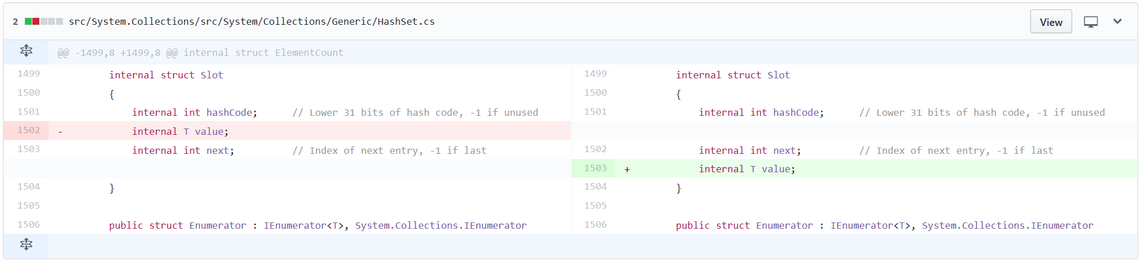
Generic Type Layouts
Optimizing generic type layouts
Putting generic fields at the end as a best
https://github.com/dotnet/corefx/pull/4103
T
Notes:
Some tips:
Keep an eye on the GitHub repo of CoreCLR and CoreFx to learn about a lot of these small optimizations as they come in:
.NET Core has an ongoing focus on improving performance across the board (especially for server workloads).

Slide 10
Put generics at the end in a struct
Put always the generics at the end to avoid additional memory consumption.
This text is coming from a commit in .Net framework in Git.
The C# compiler by default annotates structs to be sequential layout. For alignment reasons, T may need to be 8-byte aligned on 64-bit, e.g. if T is a long or an object reference, in which case with sequential layout we'll end up with a 4-byte gap between hashCode and value, as well as padding at the end of the struct. If we instead allow the runtime to lay this out optimally, e.g. hashCode then next then value, all padding in such situations can be removed.
Demo “GenericsPerformanceTest.sln”

Slide 11
Use the cancelation token pattern instead of timers
Suggestion #3

Slide 12
Timers are costly
An interesting comment in the code…
Referencesource.microsoft.com/#mscorlib/system/threading/timer.cs
Abstractions such as Task.Delay(…) use this
Pass in a cancellation token to abort the timer when possible
// Perf assumptions: We assume that timers are created and destroyed frequently, but rarely actually fire.
// There are roughly two types of timer:
//
// - timeouts for operations. These are created and destroyed very frequently, but almost never fire, because
// the whole point is that the timer only fires if something has gone wrong.
//
// - scheduled background tasks. These typically do fire, but they usually have quite long durations.
// So the impact of spending a few extra cycles to fire these is negligible.
//
// Because of this, we want to choose a data structure with very fast insert and delete times, but we can live
// with linear traversal times when firing timers.

Slide 13
Costly Timers
Asynchronous time-outs done even better
var fooCancel = new CancellationTokenSource();
var fooTask = FooAsync(fooCancel.Token);
var delayCancel = new CancellationTokenSource();
var delayTask = Task.Delay(1000, delayCancel.Token);
if (await Task.WhenAny(fooTask, delayTask) != fooTask)
{
fooCancel.Cancel();
fooTask.ContinueWith(t => { /* observe t.Exception */ });
}
else
{
delayCancel.Cancel();
}
T

Slide 14
Timers are costly
Dispose and create new timers when needed
Timers are specially optimized to get disposed rather than to get reused.

Slide 15
Task.WaitAll, again consider cancellation token
This header creates confusion:
public static bool WaitAll(Task[] tasks, int millisecondsTimeout);
millisecondsTimeout does not kill the Task(s) when the timeout is reached!
Non cancelled tasks will continue consuming resources
If a task is running but we assumed that is not, we could create unexpected behaviours/exceptions
Again, consider to use cancellation token
Demo “CancellingTasks”

Slide 16
Be careful with string.Format, could be expensive
Suggestion #4

Slide 17
Be careful with string.Format, could be expensive
String Interpolation
Is String.Format in disguise… (params object[] allocations possible)
$”This ‘{0}’ could become {1} costly if {2} and {3} and {4}…”
Note:
$”…” ≈ String.Format(“…”);
This:
result = "This " + a + " could become " + b + " costly if " + c + " and " + d + " and " + e + " and " + f + " and " + g + " stings are concatenated";
Is faster than:
result = $"This {a} could become {b} costly if {c} and {d} and {e} and {f} and {g} stings are concatenated";
T

Slide 18
Be careful with string.Format, could be expensive
If the elements are integers ToString() method will be called.
If the elements are objects ToString() method will be called. AND
Internal locks may happen
Beware of (string format, params object[] args)
Formatting may happen under locks

Slide 19
Be careful with string.Format, could be expensive
And there is something more:
result = $"This {a} could become {b} costly if {c} and {d} and {e} and {f} and {g} stings are concatenated";
Implicit boxing may happen, elements may be converted to objects. Let’s take a look at the function declaration:
public static String Format(String format, params object[] args);
Demo: ExpensiveStringFormat

Slide 20
Use global singleton instances to create empty objects
Suggestion #5

Slide 21
Using Singletons
Peanut butter everywhere…
// MethodInfo Type.GetMethod(string, Type[])
type.GetMethod(“Foo”, new Type[0])
// void Bar.Foo(params object[])
bar.Foo()
// Task<T> Task.FromResult(T value)
return Task.FromResult(0);
Isn’t GC cheap?
Lots of gen 0 “background radiation”
Can cause promotion of other objects
Easy to avoid in many cases!
T
Notes:
Some tips:
These may look like (premature) micro optimizations…
…because they typically are!
However, many of these optimizations are:
No-brainers
Extremely low risk
Great to raise awareness in your team to:
Care about performance when writing code
Urge understanding of modern language abstractions in order to appreciate possible performance implications
Gen 0 is quite cheap, but…
Anything that gets to the heap in gen 0 may get promoted to gen 1 (if you have enough stuff filling gen 0)
And it only becomes more expensive to clean up later!
Allocation on the managed heap is quite cheap as well, but…
Not allocating is (almost always) cheaper
Allocation can lead to triggering GC
It’s no excuse to allocate all over the place:
GC makes it less critical to think about memory management all the time
But GC isn’t an excuse to completely stop thinking about memory management
Appreciate what the GC can do for you, but don’t forget it’s there and it has its own costs

Slide 22
Using Singletons
Peanut butter everywhere…
// MethodInfo Type.GetMethod(string, Type[])
type.GetMethod(“Foo”, new Type[0])
// void Bar.Foo(params object[])
bar.Foo()
// Task<T> Task.FromResult(T value)
return Task.FromResult(0);
Isn’t GC cheap?
Lots of gen 0 “background radiation”
Can cause promotion of other objects
Easy to avoid in many cases!
New instance of new Type[0] every time that this method is called
New instance of new object[0] every time that this method is called
Creates a Task<TResult> that's completed successfully with the specified result.
T
Notes:
Some tips:
These may look like (premature) micro optimizations…
…because they typically are!
However, many of these optimizations are:
No-brainers
Extremely low risk
Great to raise awareness in your team to:
Care about performance when writing code
Urge understanding of modern language abstractions in order to appreciate possible performance implications
Gen 0 is quite cheap, but…
Anything that gets to the heap in gen 0 may get promoted to gen 1 (if you have enough stuff filling gen 0)
And it only becomes more expensive to clean up later!
Allocation on the managed heap is quite cheap as well, but…
Not allocating is (almost always) cheaper
Allocation can lead to triggering GC
It’s no excuse to allocate all over the place:
GC makes it less critical to think about memory management all the time
But GC isn’t an excuse to completely stop thinking about memory management
Appreciate what the GC can do for you, but don’t forget it’s there and it has its own costs

Slide 23
Using Singletons
Peanut butter everywhere…
// MethodInfo Type.GetMethod(string, Type[])
type.GetMethod(“Foo”, Type.EmptyTypes)
// void Bar.Foo(params object[])
bar.Foo(Array.Empty<object>()) // latest C# compiler does this!
// Task<T> Task.FromResult(T value)
return Task.CompletedTask;
Isn’t GC cheap?
Lots of gen 0 “background radiation”
Can cause promotion of other objects
Easy to avoid in many cases!
Singleton array
Singleton array
Singleton completed task
T
Notes:
Some tips:
These may look like (premature) micro optimizations…
…because they typically are!
However, many of these optimizations are:
No-brainers
Extremely low risk
Great to raise awareness in your team to:
Care about performance when writing code
Urge understanding of modern language abstractions in order to appreciate possible performance implications
Gen 0 is quite cheap, but…
Anything that gets to the heap in gen 0 may get promoted to gen 1 (if you have enough stuff filling gen 0)
And it only becomes more expensive to clean up later!
Allocation on the managed heap is quite cheap as well, but…
Not allocating is (almost always) cheaper
Allocation can lead to triggering GC
It’s no excuse to allocate all over the place:
GC makes it less critical to think about memory management all the time
But GC isn’t an excuse to completely stop thinking about memory management
Appreciate what the GC can do for you, but don’t forget it’s there and it has its own costs

Slide 24
Using Singletons
Check this out!
https://github.com/aspnet/Docs/issues/1940
Note well:
Global singletons should be used for read only. If there are a lot of references to that object, any change will affect all references.
Examples we’ve seen like Object[] are immutable and we can perform only read/querying operations.
This pattern works well in conjunction with immutable objects.
Demo: Singletons

Slide 25
Advantages of immutable pattern (in performance)
Suggestion #6

Slide 26
Advantages of immutable pattern (in performance)
Immutable pattern means that no property of the object can be modified.
Advantages:
Really safe in multithreading.
Disadvantages:
This pattern can’t be used in objects that are modified often.
Be aware of the excessive cloning.
Be careful with pointers to objects! Use defensive copy pattern.
String is an example of immutable objects. All functions and properties return a new instance with the modification.
str1.Replace("a", "b"); //unuseful
str2 = str1.Replace("a", "b"); //useful ;)

Slide 27
Structs are good candidates for immutable pattern
Suggestion #7

Slide 28
Properties based in structs
Consider:
Every time that you access a struct through a property a copy is created
This has implications in memory management
This has advantages for immutable pattern
Demo: PropertiesBasedInStructs

Slide 29
Working with Linq, know well when data is allocated in memory
Suggestion #8

Slide 30
Execution of Linq queries
Possible performance leak: An IEnumerable object returned from a Linq query is a collection that is not allocated in memory. Objects are allocated when the query is executed so Count() means to loop all items because is not possible to know upfront the result
Solution:
If a repeated access to all elements is needed generate a collection by executing the query (ToList())
Then
Count it’ll be a pre-calculated property and
The access to items will be directly to memory
Solution (2): use Any() if you really want to know if there is some element

Slide 31
Execution of Linq queries Quiz (I)
Which piece of code is faster?
A:
B:
var filteredEnumerable = list.Where(x => (x > filter));
var loops = 0;
var n = filteredEnumerable.Count();
n = filteredEnumerable.Count();
foreach (var element in filteredEnumerable)
{
loops++;
}
var filteredList = list.Where(x => (x > filter)).ToList();
n = filteredList.Count();
n = filteredList.Count();
foreach (var element in filteredList)
{
loops++;
}

Slide 32
Execution of Linq queries Quiz (I)
Which piece of code is faster?
A:
B! The elements are allocated into memory only once
var filteredEnumerable = list.Where(x => (x > filter));
var loops = 0;
var n = filteredEnumerable.Count();
n = filteredEnumerable.Count();
foreach (var element in filteredEnumerable)
{
loops++;
}
var filteredList = list.Where(x => (x > filter)).ToList();
n = filteredList.Count();
n = filteredList.Count();
foreach (var element in filteredList)
{
loops++;
}

Slide 33
Execution of Linq queries Quiz (II)
Which piece of code is faster?
A:
B:
var loops = 0;
foreach (var element in list.Where(x => (x > filter)))
{
loops++;
}
var loops = 0;
foreach (var element in list.Where(x => (x > filter)).ToList())
{
loops++;
}

Slide 34
Execution of Linq queries Quiz (II)
Which piece of code is faster?
A, only one loop, no reason to call IEnumerable twice:
B:
var loops = 0;
foreach (var element in list.Where(x => (x > filter)))
{
loops++;
}
var loops = 0;
foreach (var element in list.Where(x => (x > filter)).ToList())
{
loops++;
}

Slide 35
Execution of Linq queries Quiz (III)
Which piece of code is faster?
A
A:
B
for (int i = 0; i < 5; i++)
{
foreach (var element in list.Where(x => (x > filter)))
{
loops++;
}
}
for (int i = 0; i < 5; i++)
{
foreach (var element in list.Where(x => (x > filter)).ToList())
{
loops++;
}
}

Slide 36
Execution of Linq queries Quiz (III)
Which piece of code is faster? The right answer is none is correct
A, IEnumerable will be called 5 times, in the second example 10!:
A:
B, TOTAL DISASTER this code is NOT correct in terms of performance :
for (int i = 0; i < 5; i++)
{
foreach (var element in list.Where(x => (x > filter)))
{
loops++;
}
}
for (int i = 0; i < 5; i++)
{
foreach (var element in list.Where(x => (x > filter)).ToList())
{
loops++;
}
}

Slide 37
Execution of Linq queries Quiz (IV)
Which piece of code is faster?
A:
B:
for (int i = 0; i < 5; i++)
{
foreach (var element in list.Where(x => (x > filter)))
{
loops++;
}
}
filteredList = list.Where(x => (x > filter)).ToList();
for (int i = 0; i < 5; i++)
{
foreach (var element in filteredList)
{
loops++;
}
}

Slide 38
Execution of Linq queries Quiz (IV)
Which piece of code is faster?
A:
B, the elements are allocated only once:
for (int i = 0; i < 5; i++)
{
foreach (var element in list.Where(x => (x > filter)))
{
loops++;
}
}
filteredList = list.Where(x => (x > filter)).ToList();
for (int i = 0; i < 5; i++)
{
foreach (var element in filteredList)
{
loops++;
}
}

Slide 39
Execution of Linq queries Quiz (IV)
"IEnumerablePerformance.sln“

Slide 40
ConcurrentDictionary<K, V> can be great…
Suggestion #9

Slide 41
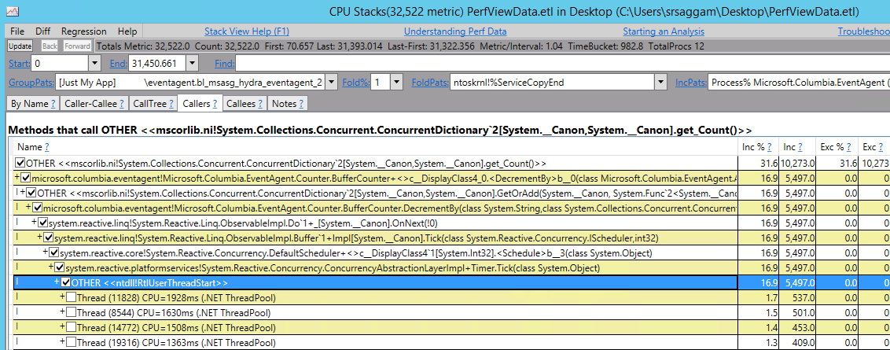
ConcurrentDictionary<K, V> can be great…
ConcurrentDictionary<K, V> can be great…
…but beware of big locks (e.g. Count)
T
Notes:
Some tips:
It’s not because it starts with `Concurrent` that it’s cheap or fast for all use cases.
Concurrent collections may be expensive in terms of memory, especially if you don’t use them in a highly concurrent manner.
Some operations such as `Count` can be expensive because they need to acquire a lot of fine-grained locks (i.e. more expensive than a simple lock over a collection).
Understand the hidden costs.

Slide 42
ConcurrentDictionary<K, V> can be great…
Some tips:
It’s not because it starts with “Concurrent” that it’s cheap or fast for all use cases.
Concurrent collections may be expensive in terms of memory, especially if you don’t use them in a highly concurrent manner.
Some operations such as “Count” can be expensive because they need to acquire a lot of fine-grained locks (i.e. more expensive than a simple lock over a collection).
Understand the hidden costs.

Slide 43
When loading massive data in sorted/unique collections…
Suggestion #10

Slide 44
When loading massive data in sorted/unique collections…
Dictionary is:
Faster to query and get elements. Uses a key while plain lists do not (List is a collection a tree index)
Slower when adding or removing elements (when an insert or update is performed the index needs to be rebalanced)
So:
With some size of elements to sort or to get a distinct subset of elements is better:
Add all elements in a plain collection without any sort (list)
Sort in one step. Frameworks usually work with Quicksort algorithm with an average complexity in O(n.log(n)) which usually makes it the fastest. The worst-case complexity in O(n2) is only when elements are sorted in reverse-order.
If you need to get a distinct subset of elements, once the list is sorted it’s easy to create the Dictionary with a single loop.
See the animation: https://www.cs.usfca.edu/~galles/visualization/AVLtree.html

Slide 45
When loading massive data in sorted/unique collections…
HashSet is:
Faster to add unique elements and to control repeated elements.
Does not provide any method to access the element directly, only a query if exists or full iteration
Is faster to add elements from an unsorted list in memory than a sorted list or data read directly from disk
So:
If you only need to control the existence of some element and/or avoid duplicated values is a fast collection
To load massively from a file is better to load this file in a plan list without any control and use the Hashset constructor.
Demo: " CollectionTests“

Slide 46
Too Much LINQ
Suggestion #11

Slide 47
Too Much LINQ
Using LINQ to Objects for trivial tasks…
Lazy evaluation can be your enemy!
ToArray may not know upfront how many elements there will be…
Select has to invoke a delegate for each element…
High-school loops aren’t that bad!
Bar[] ConvertToBars(Foo[] foos) => foos.Select(foo => GetBar(foo)).ToArray();
Bar[] ConvertToBars(Foo[] foos) {
var n = foos.Length;
var res = new Bar[n];
for (var i = 0; i < n; i++)
res[i] = GetBar(foos[i]);
return res;
}
T
Notes:
Some tips:
Improvements to LINQ to Objects have been made in .NET Core, making these issues less pressing.
However, in performance critical code, trivial uses of LINQ can often be avoided:
This is truly low-hanging fruit.
Assess the complexity of your queries (e.g. a GroupBy or OrderBy may be far less easy to eliminate in a risk-free manner).

Slide 48
Environment.MachineName
Suggestion #12

Slide 49
Environment.MachineName
Environment.MachineName
Allocates a string each time…
…because your machine name may change?

Slide 50
foreach function in list
Suggestion #13

Slide 51
Foreach function in list
Foreach function in List collection is optimized for full loops
list2.ForEach(element => element++);
Demo: " ForEachListLoops“

Slide 52
Tools

Slide 53
WinDbg and SOS, SOSEX

Slide 54
WinDbg and SOS, SOSEX
Hardcode debugging to inspect CLR data structures
Step 0 – Get WinDbg
www.bing.com/search?q=windbg+download
Step 1 – Attach to target
F6 to attach to a process
CTRL-D to load a crash dump
CTRL-E to start afresh from an .exe (“F5”)
Step 2 – Load SOS
.loadby sos clr
Step 3 – Run SOS commands
!help to start

Slide 55
WinDbg and SOS, SOSEX
************* Symbol Path validation summary **************
Response Time (ms) Location
Deferred srv*c:\symbols*\\symbols\symbols
Symbol search path is: srv*c:\symbols*\\symbols\symbols
Executable search path is:
ModLoad: 00000000`00770000 00000000`007f6000 C:\Tools\ILSpy\ILSpy.exe
ModLoad: 00007ff8`72a70000 00007ff8`72c4b000 C:\WINDOWS\SYSTEM32\ntdll.dll
ModLoad: 00007ff8`5dee0000 00007ff8`5df43000 C:\WINDOWS\SYSTEM32\MSCOREE.DLL
ModLoad: 00007ff8`72660000 00007ff8`7270e000 C:\WINDOWS\System32\KERNEL32.dll
ModLoad: 00007ff8`6f5e0000 00007ff8`6f829000 C:\WINDOWS\System32\KERNELBASE.dll
ModLoad: 00007ff8`72950000 00007ff8`729f1000 C:\WINDOWS\System32\ADVAPI32.dll
...
(3da8.f18): Break instruction exception - code 80000003 (first chance)
ntdll!DbgBreakPoint:
00007ff8`72b18d70 cc int 3
0:020> .loadby sos clr
0:020> !help

Slide 56
PerfView tool

Slide 57
PerfView tool
PerfView is a powerful free tool to trace the performance in an application
Allows to evaluate the cost of each function
Good videos and tutorials to get started

Slide 58
PerfView tool
Step 0 – Get PerfView
www.bing.com/search?q=perfview+download
Step 1 – Collect a trace
Collect, Run to start afresh (F5)
Collect, Collect to capture running processes
Set various options
Step 2 – Explore traces

Slide 59
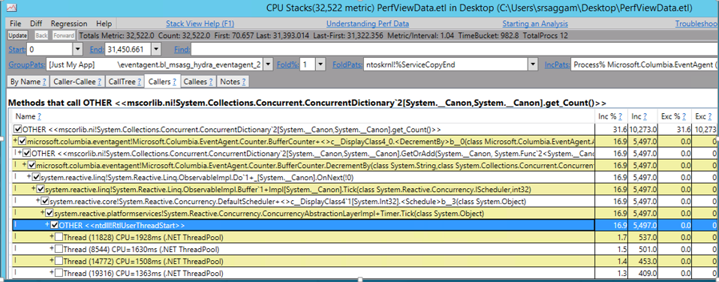
Perf view tool
Shows the % of the time consumed for each function hierarchically

Slide 60
CLR Profiler

Slide 61
CLR Profiler
The CLR Profiler allows developers to see the allocation profile of their managed applications:
Histogram of allocated types
Allocation and call graphs
Time line showing GCs of various generations
Resulting state of the managed heap after those collections
Call tree showing per-method allocations and assembly loads.
More info: https://msdn.microsoft.com/en-us/library/ff650691.aspx

Slide 62
Miscellaneous & Some safe and secure coding notes

Slide 63
Catching exceptions, do not use I/O to trace an I/O exception

Slide 64
Catching exceptions, do not use I/O to trace an I/O exception
What’s wrong in this code?
try
{
System.IO.File.WriteAllText(someFile, someContent);
}
catch (Exception e)
{
System.IO.File.WriteAllText("pathToExceptionFile", e.ToString());
}

Slide 65
Catching exceptions, do not use I/O to trace an I/O exception
What’s wrong in this code?
try
{
System.IO.File.WriteAllText(someFile, someContent);
}
catch (Exception e)
{
System.IO.File.WriteAllText("pathToExceptionFile", e.ToString());
}
Also consider the same when catching sockets exceptions
Death spiral!

Slide 66
Improved Performance in C# 7

Slide 67
Improved Performance in C# 7
You can declare nested functions
The scope is reduced
But you can save stack allocation
Return values and local variables by reference… like C++ ;)
You’ll save copying of data
Be careful, you’ll modify the original memory location

Slide 68
Pre-warming when Initializing Volumes from Snapshots in aws

Slide 69
Pre-warming when Initializing Volumes from Snapshots in aws
There is a significant increase in latency when you first access each block of data on a new EBS volume that was restored from a snapshot. You can avoid this performance hit by accessing each block prior to putting the volume into production. This process is called initialization(formerly known as pre-warming). For more information, see Initializing Amazon EBS Volumes.

Slide 70
Do not get frustrated

Slide 71
Do not get frustrated
Small changes are powerful!

Slide 72
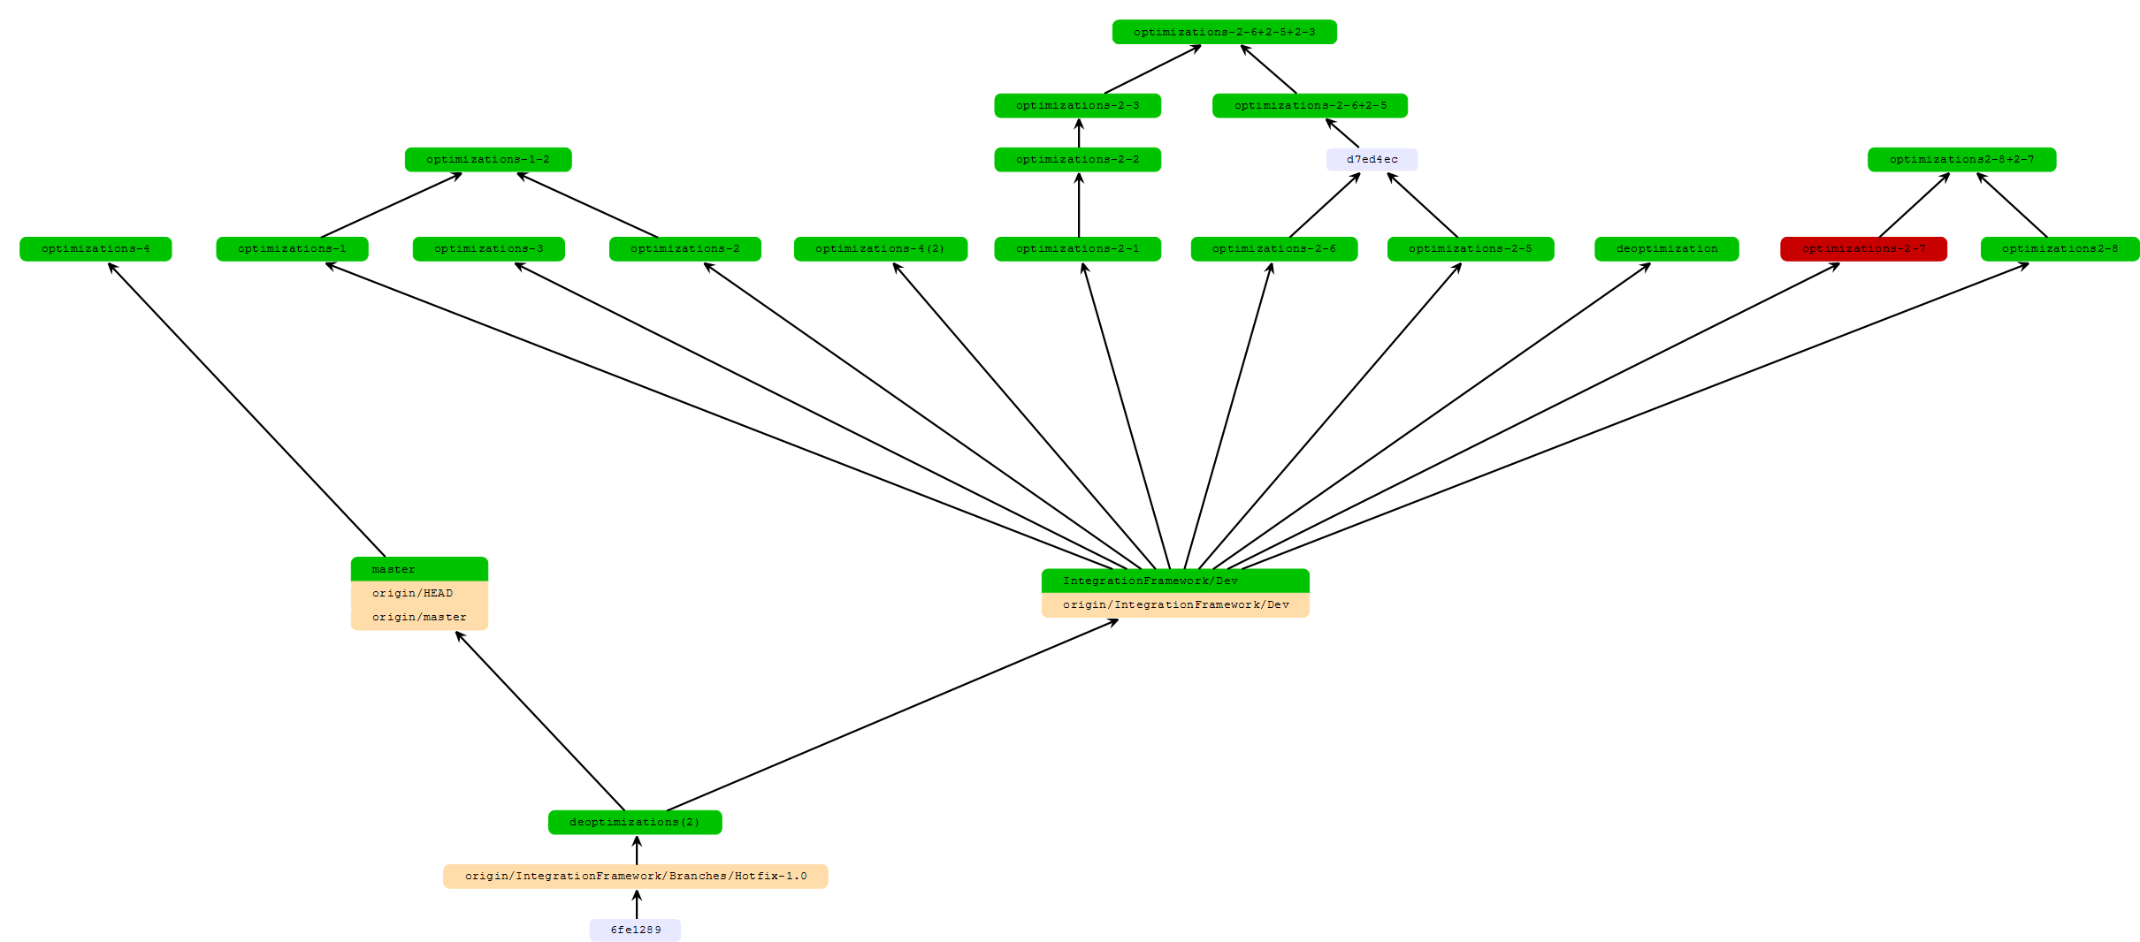
Do not get frustrated
Quite faster(50%)
Few seconds faster (10%)
Few seconds faster (10%)
Few milliseconds faster
Few seconds faster (15%)
Few milliseconds faster

Slide 73
Huge Exceptions, oh my!

Slide 74
Huge Exceptions, oh my!
AggregateException has a very expensive implementation of ToString()
Logging is great…
…but know how large it may get
…especially with AggregateException
/// <summary>
/// Creates and returns a string representation of the current <see cref="AggregateException"/>.
/// </summary>
/// <returns>A string representation of the current exception.</returns>
public override string ToString() {
string text = base.ToString();
for (int i = 0; i < m_innerExceptions.Count; i++) {
text = String.Format(
CultureInfo.InvariantCulture,
Environment.GetResourceString("AggregateException_ToString"),
text, Environment.NewLine, i, m_innerExceptions[i].ToString(), "<---", Environment.NewLine);
}
return text;
}
T
Notes:
Some tips:
Blindly calling ToString on a potentially open-ended set of types can cause issues, e.g.
AggregateException has a *very* expensive implementation of ToString which is heavy in terms of allocations due to string concatenations happening to print *all* inner exceptions.
TargetInvocationException often doesn’t get unwrapped after calling reflection APIs, causing obfuscation of the real underlying exception that occurred.
Always beware of hidden sources of ToString, e.g.
String.Format(…)
$”…” string interpolation
Sometimes it’s good to write custom “ToStringSafe” extension methods to:
deal with “quirks”,
have a single plac,e where string printing logic is controlled, and,
make it blatantly obvious where printing happens (and possibly start weeding out places where it’s not justified).

Slide 75
Huge Exceptions, oh my!
Some tips:
Blindly calling ToString on a potentially open-ended set of types can cause issues, e.g.
AggregateException has a very expensive implementation of ToString which is heavy in terms of allocations due to string concatenations happening to print all inner exceptions.
TargetInvocationException often doesn’t get unwrapped after calling reflection APIs, causing obfuscation of the real underlying exception that occurred.
Always beware of hidden sources of ToString, e.g.
String.Format(…)
$”…” string interpolation
Sometimes it’s good to write custom “ToStringSafe” extension methods to:
deal with “quirks”,
have a single place where string printing logic is controlled, and,
make it blatantly obvious where printing happens (and possibly start weeding out places)

Slide 76
Infinite Regex

Slide 77
Infinite Regex
Always timeout string validation using regex. Some apparently basic validations could take long time. Or:
Try to use implementations without backreferences
An interesting project from Google: RE2 is a fast, safe, thread-friendly alternative to backtracking regular expression engines like those used in PCRE, Perl, and Python. It is a C++ library. https://github.com/google/re2
Demo: Regex

Slide 78
Zip bombs

Slide 79
Zip bombs
42.zip - zip file consisting of 42 kilobytes of compressed data, containing five layers of nested zip files in sets of 16, each bottom layer archive containing a 4.3 gigabyte file for a total of 4.5 petabytes when uncompressed

